Slide 1
SOFTWARE SPECIALIST
QA 22FebEnable3
DAIGOR RODRIGUES

Slide 2
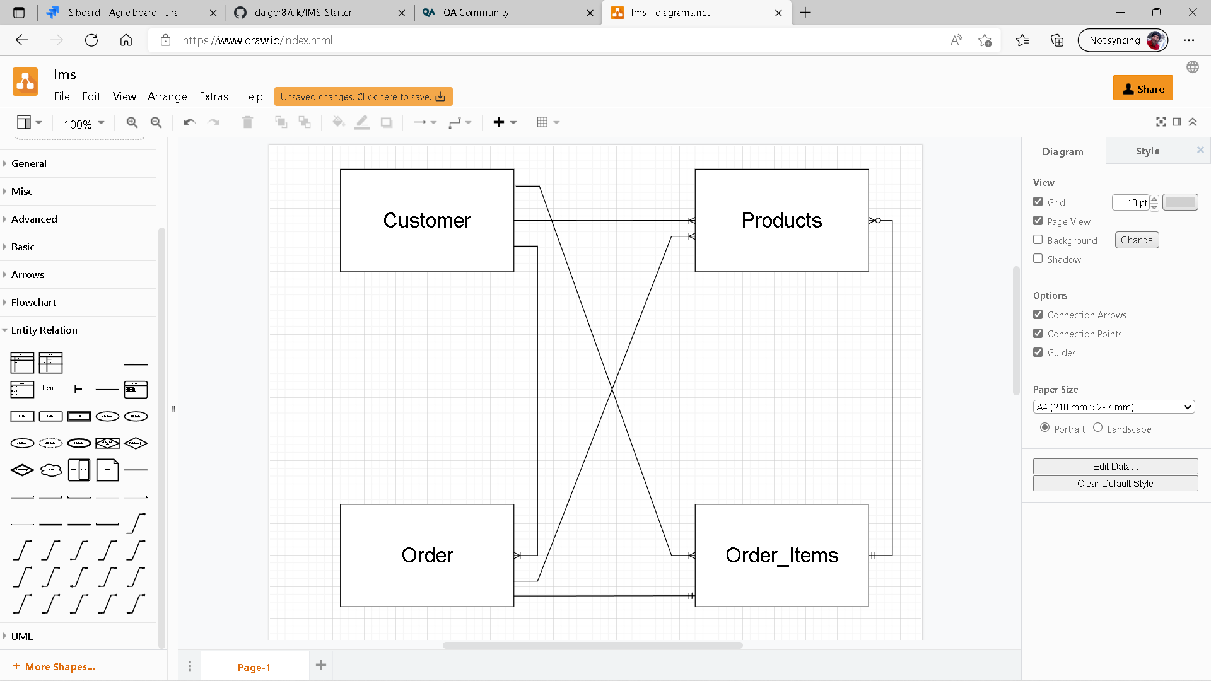
IMS Starter Project

Slide 3
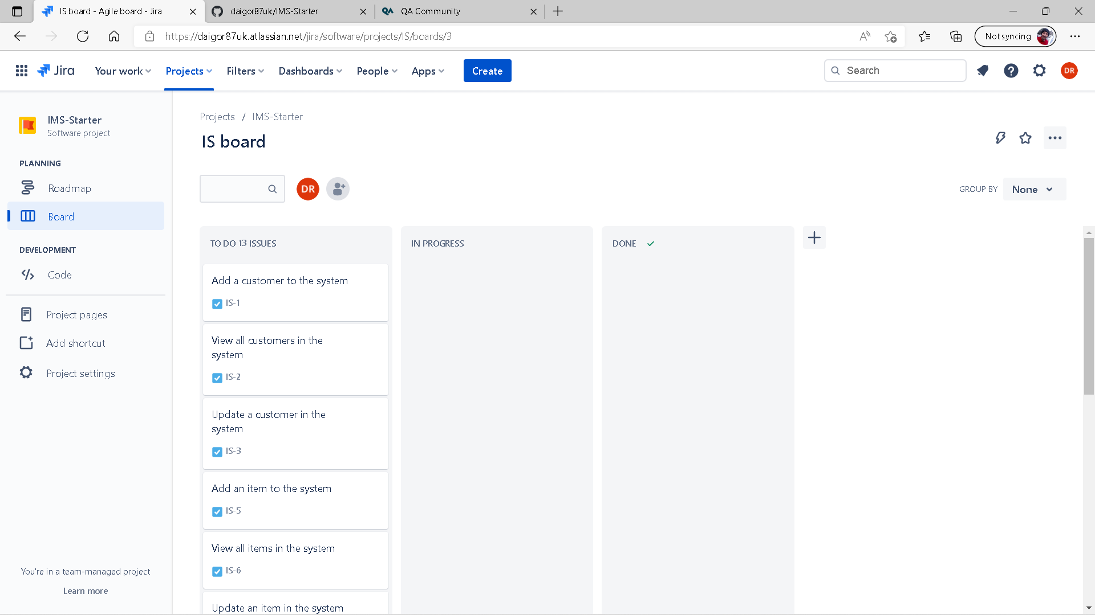
Then Jira Boards

Slide 4
Lets go on coding
So after a few sweating and jiggling work / learning experiences, the code is looking better, improved, connected and on git hub.

Slide 5
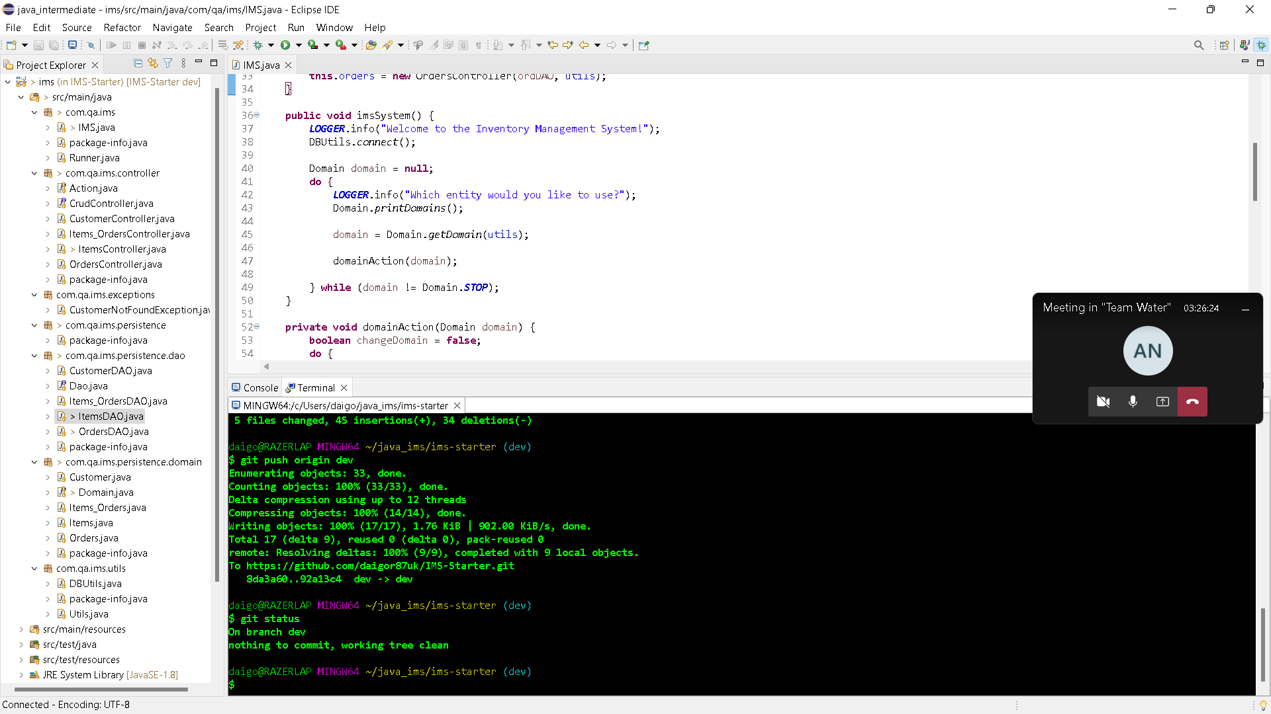

Slide 6
The “dark side”
After a few days working with bright themes, I’ve managed to actually change MySql and Eclipse to dark mode, which makes working on code more pleasant.

Slide 7
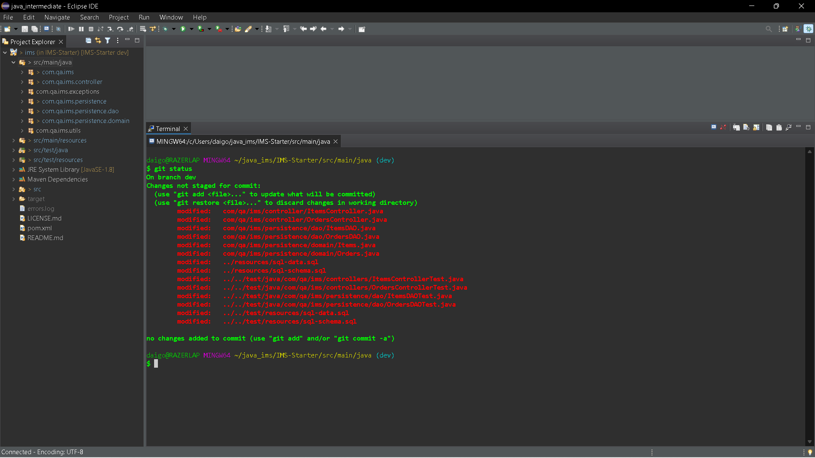

Slide 8
Coding and modifying
After a few problems and issues, I’ve come to a part where I’ve deleted my all project by committing wrong files, deleting the wrong files, pushing up wrong work. That’s where the group came in to help me, as I was really worried about it. So special thanks to everyone who supported me on the group, regaining my project back, and uploaded again on GitHub.

Slide 9
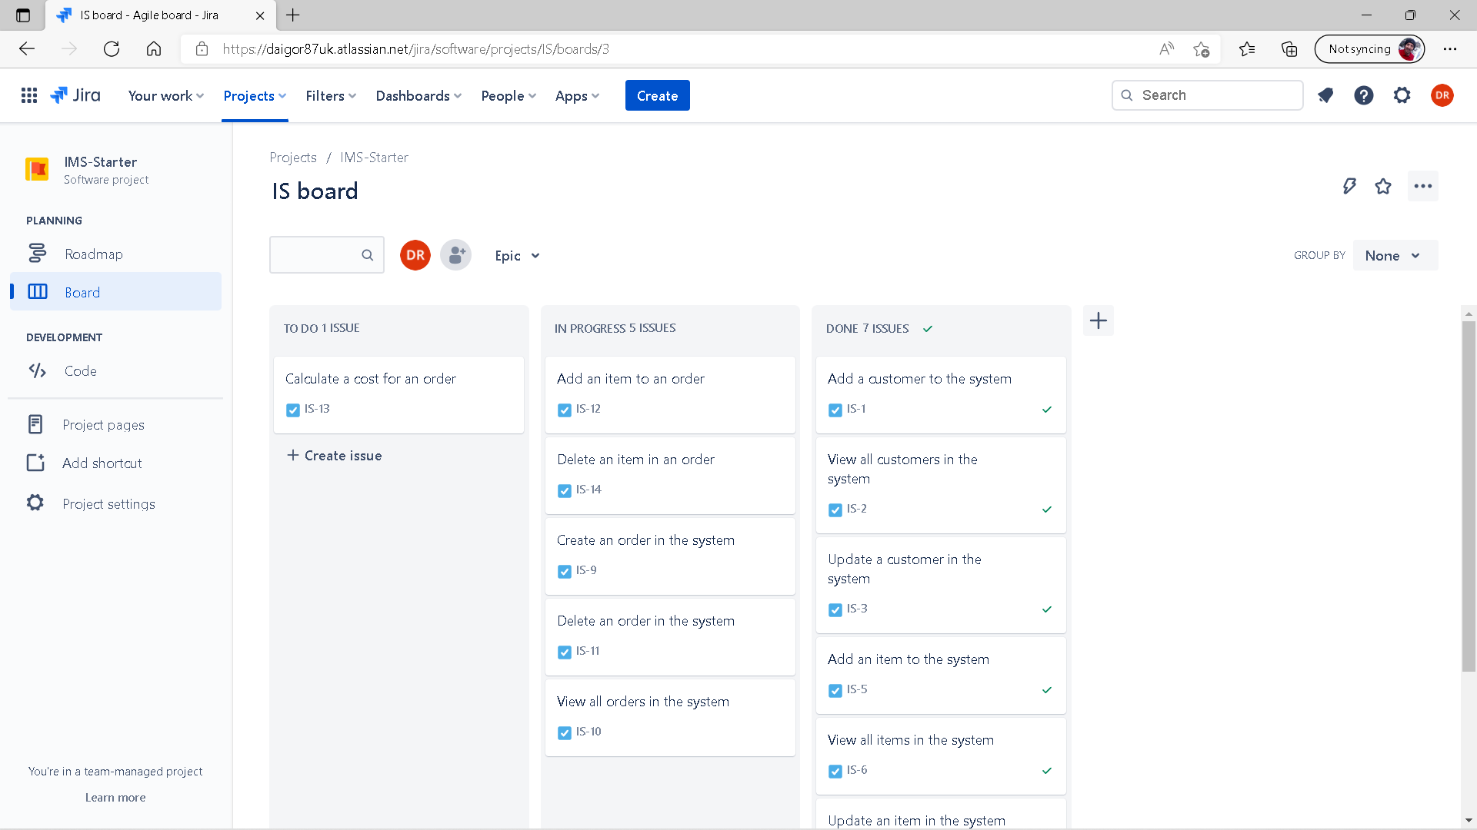

Slide 10
Realization
I realized the coding part was actually the easiest, because the planning, thinking about the risks, drawing relations, requires a bit of a thinking, and anything you change, changes your code, that’s where the policies comes in handy, so you can update your code without breaking it.

